Slide 1
Campus Network Design & Implementation
Aurum Joshi 22BLC1382
Keshika Swetha D 22BLC1184

Slide 2
INTRODUCTION
In today’s educational environment, universities rely on scalable and efficient networks to support both data and communication services across multiple campuses. This project focuses on the design and implementation of a campus network, ensuring seamless connectivity for students, faculty, and administration across departments.
Objective
To design and implement a scalable, reliable, and secure campus network that supports multiple faculties, providing connectivity and access to internal and external resources.

Slide 3
Network Specifications
Main Campus Overview
Building A: Administrative staff, HR, finance, Faculty of Business
Building B: Faculty of Engineering/Computing, Faculty of Art/Design
Building C: Student labs, IT department (web and other servers)
External Cloud: Email server hosted externally
Each building connected via high-speed links with dedicated VLANs for segmentation
Smaller Campus Overview
Faculty of Health and Sciences with dedicated floors for staff and students
Linked with the main campus via secure WAN links

Slide 4
Technologies to be Implemented
Cisco Packet Tracer: Utilize for network topology simulation and visualization.
VLANs: Implement for traffic segmentation across faculties and departments.
Inter-VLAN Routing (Router on a Stick): Configure for communication between VLANs.
DHCP Server: Set up for dynamic IP addressing.
Port-Security: Apply measures to enhance VLAN security.
SSH: Enable for secure remote management.
WLAN: Design and configure, including access points.
Host Configurations: Configure devices for network connectivity.
Hierarchical Network Design: Implement core, distribution, and access layers.
Core Layer: High-speed backbone of the network.
Distribution Layer: Aggregates data from the access layer and forwards it to the core layer.
Access Layer: Connects end devices to the network.
RIPv2: Implement for internal network routing.
Static Routing: Use for external connections.
VLAN ACLs: Apply for traffic filtering and security.

Slide 5
Building A Configuration
Administrative departments and Faculty of Business
VLANs to separate traffic for management, HR, finance, and business faculty
Router-based DHCP for dynamic IP allocation
Switch configuration for VLAN trunking between floors and departments

Slide 6
Building B and Building C Configuration
Building B: Separate VLANs for Engineering/Computing and Art/Design faculties
Building C: Student labs and IT department
IT department hosting university web servers, student database, and intranet
Security: Firewall configurations for securing sensitive data
VLAN for lab environments, enabling secure, isolated network segments for students

Slide 7
Connectivity to Smaller Campus
WAN Link: Secure connection between the main and smaller campuses (20 miles apart)
VLANs for staff and student separation at the Faculty of Health and Sciences
Dynamic Routing via RIPv2 for internal networks
Static Routing for secure access to the external email server

Slide 8
Key Features
VLAN Segmentation:
Logical separation of traffic between departments to enhance security and performance.
Dynamic IP Allocation:
DHCP servers ensure automatic IP address assignment for all devices.
RIPv2 Routing:
Dynamic routing for efficient communication between campuses.
High Availability:
Redundant links ensure continuous connectivity and minimize downtime.
Security Configurations:
VLAN ACLs and port security prevent unauthorized access and filter traffic.
Scalability:
Designed to support future growth without major network changes.
Remote Management:
SSH enables secure remote access for network management.
Centralized Server Access:
Easy access to internal servers and external resources from both campuses.
Wireless Access Points (WAPs):
WAPs deployed across the campus provide wireless connectivity for staff and students.

Slide 9
Implementation Tasks
Task 1: Plan and design network topology in Cisco Packet Tracer
Task 2: Configure switches, routers, and VLANs for departmental isolation and communication
Task 3: Evaluate network performance, reliability, scalability, and security

Slide 10
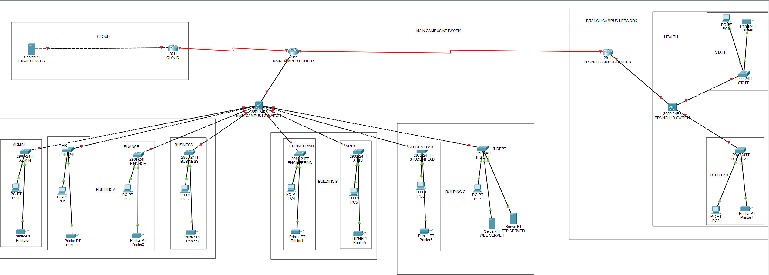
Proposed Design of Network

Slide 11
Conclusion
The proposed network design ensures that the campus network is scalable, secure, and capable of supporting the university’s operational needs. The use of VLANs, dynamic routing, and security features guarantees a flexible and robust infrastructure capable of growing with the university’s future demands.

